Slide 1
Machine learning workflow
Machine Learning with Python

Slide 2
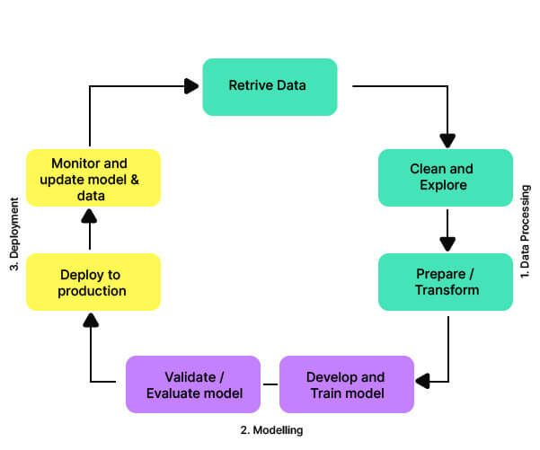
Machine Learning Workflow

Slide 3
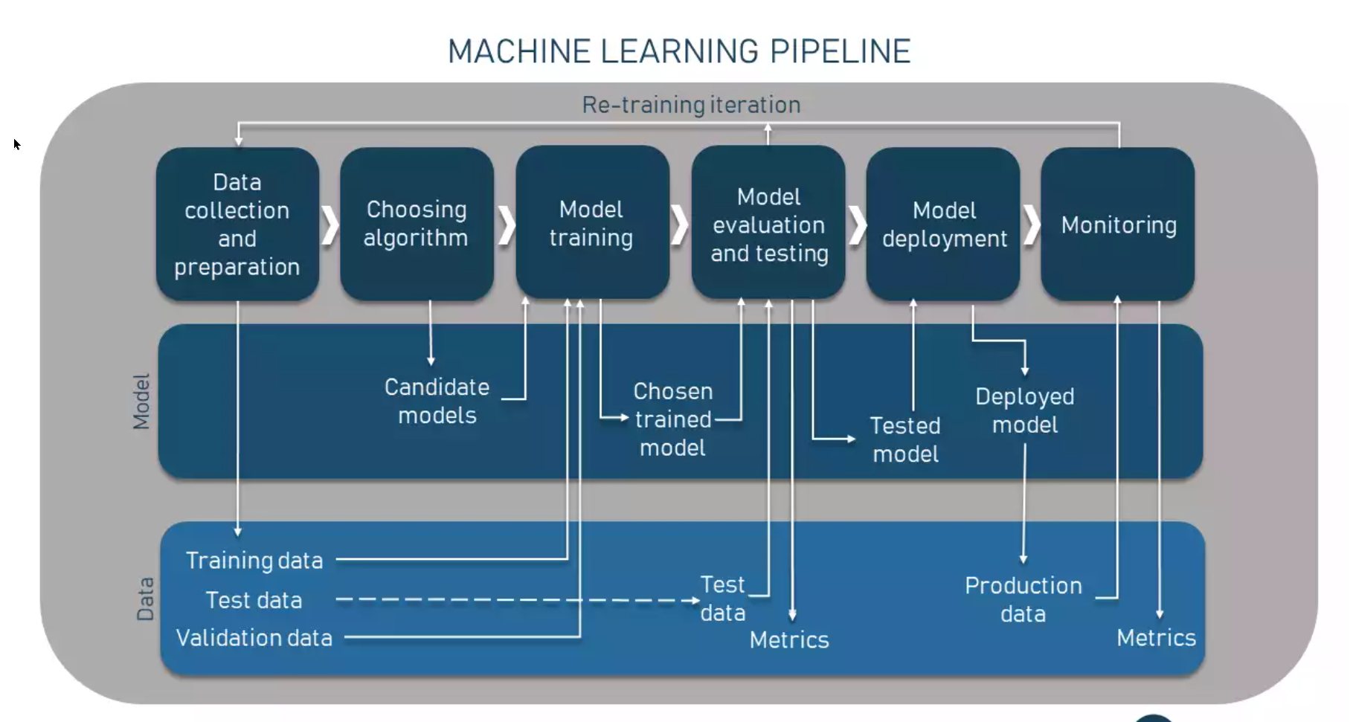

Slide 4
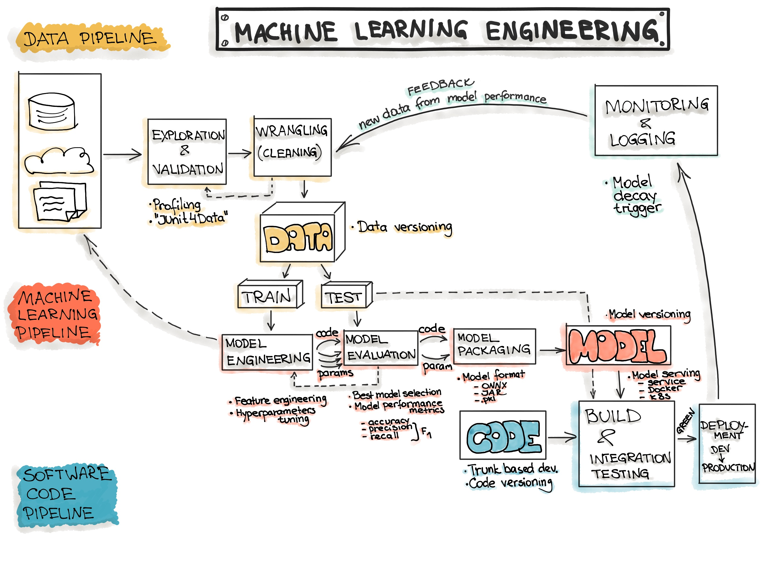

Slide 5
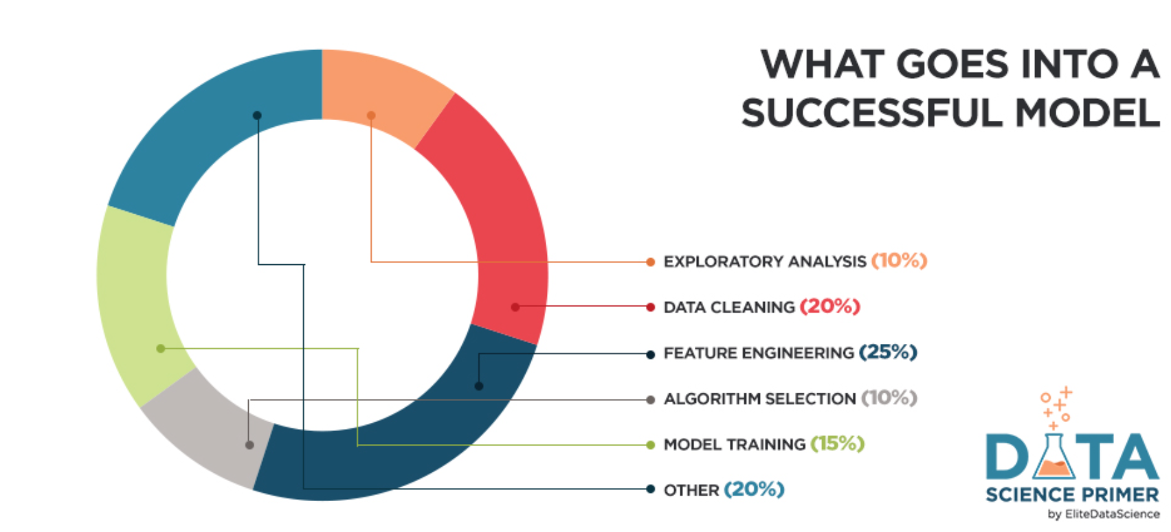

Slide 6
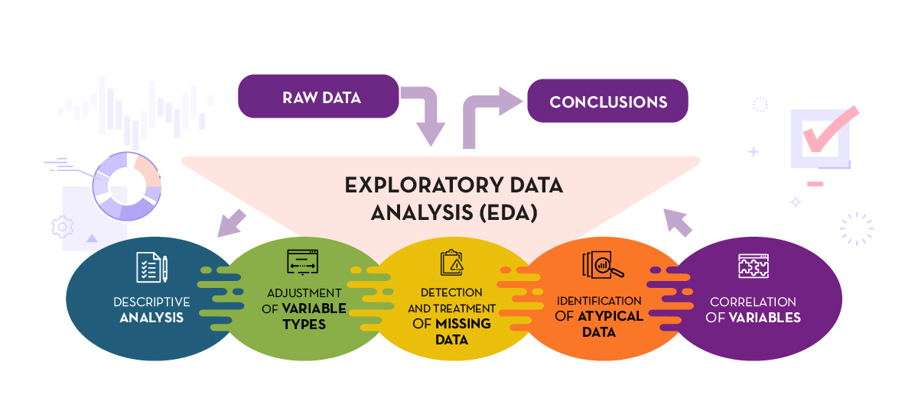

Slide 7
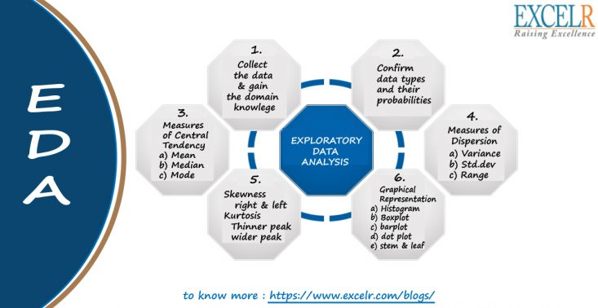

Slide 8
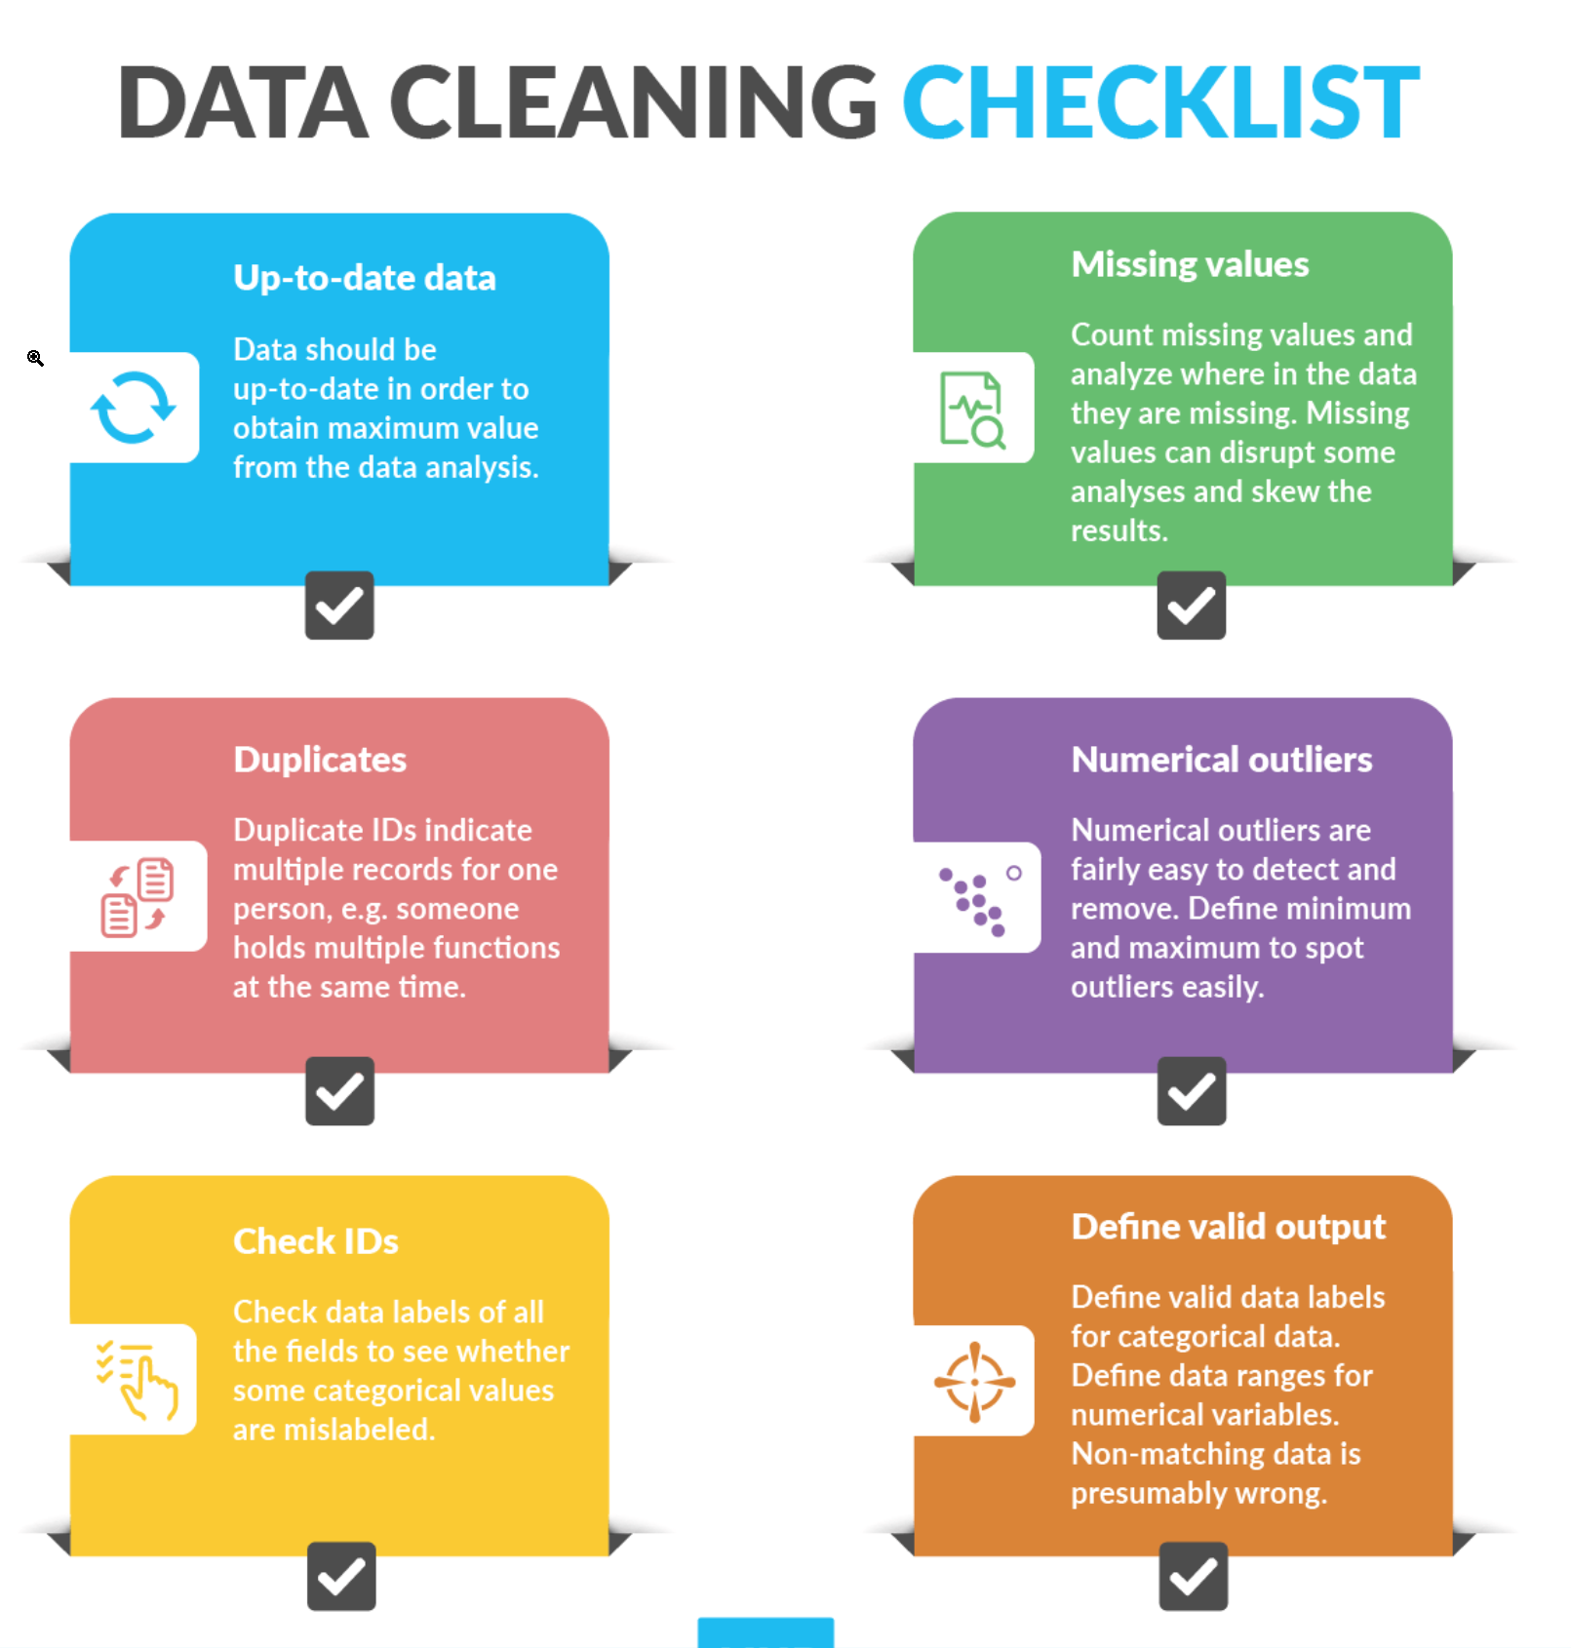

Slide 9
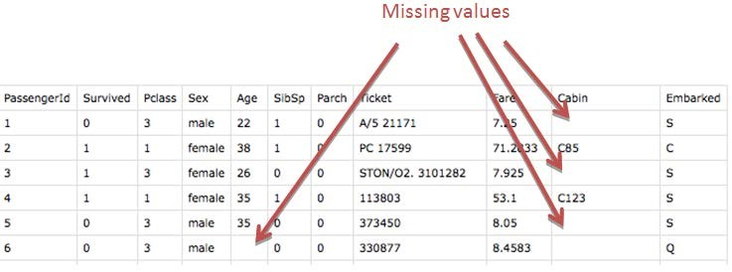

Slide 10
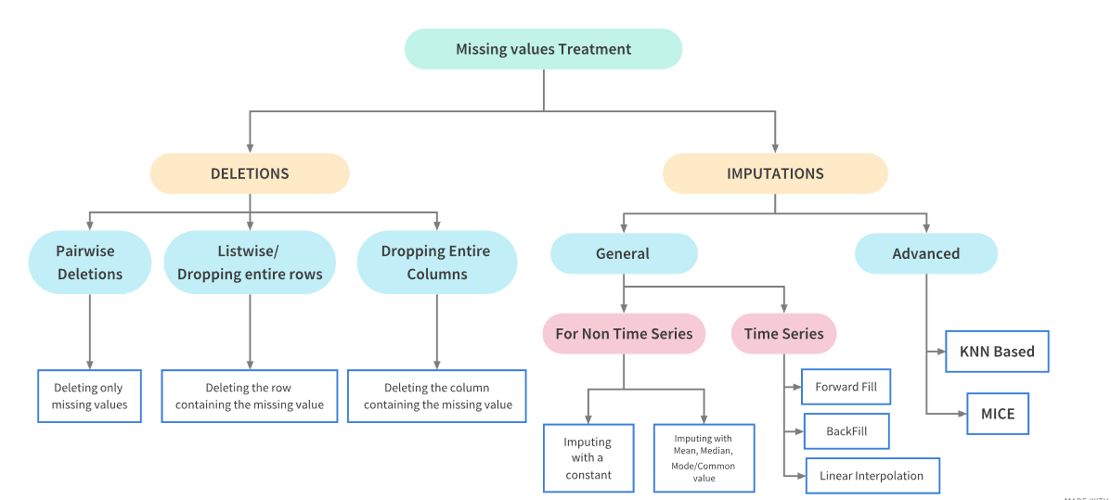

Slide 11
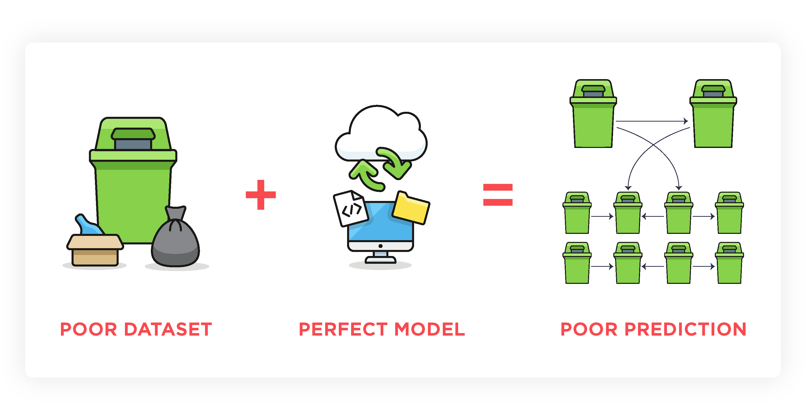
Why clean ? Garbage in, Garbage out !

Slide 12
Feature Engineering
Machine Learning in Python

Slide 13
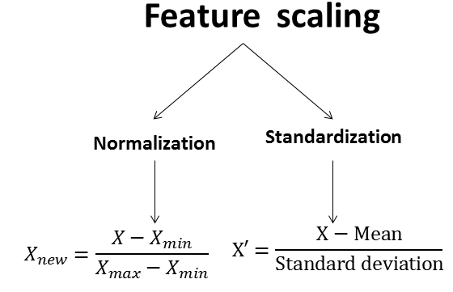

Slide 14
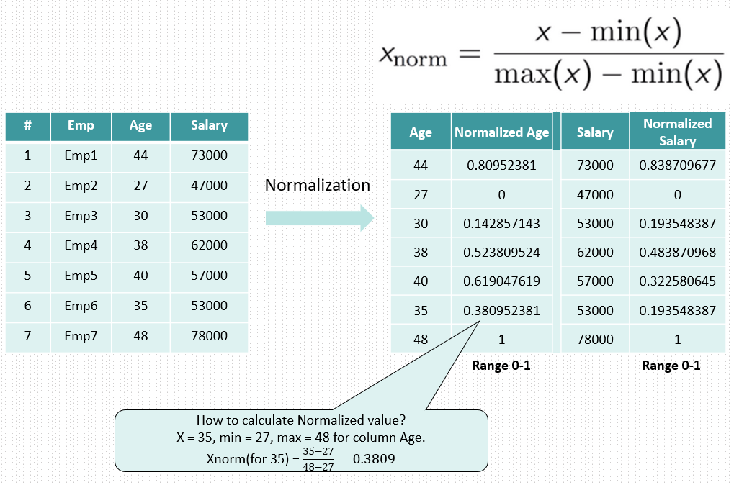

Slide 15
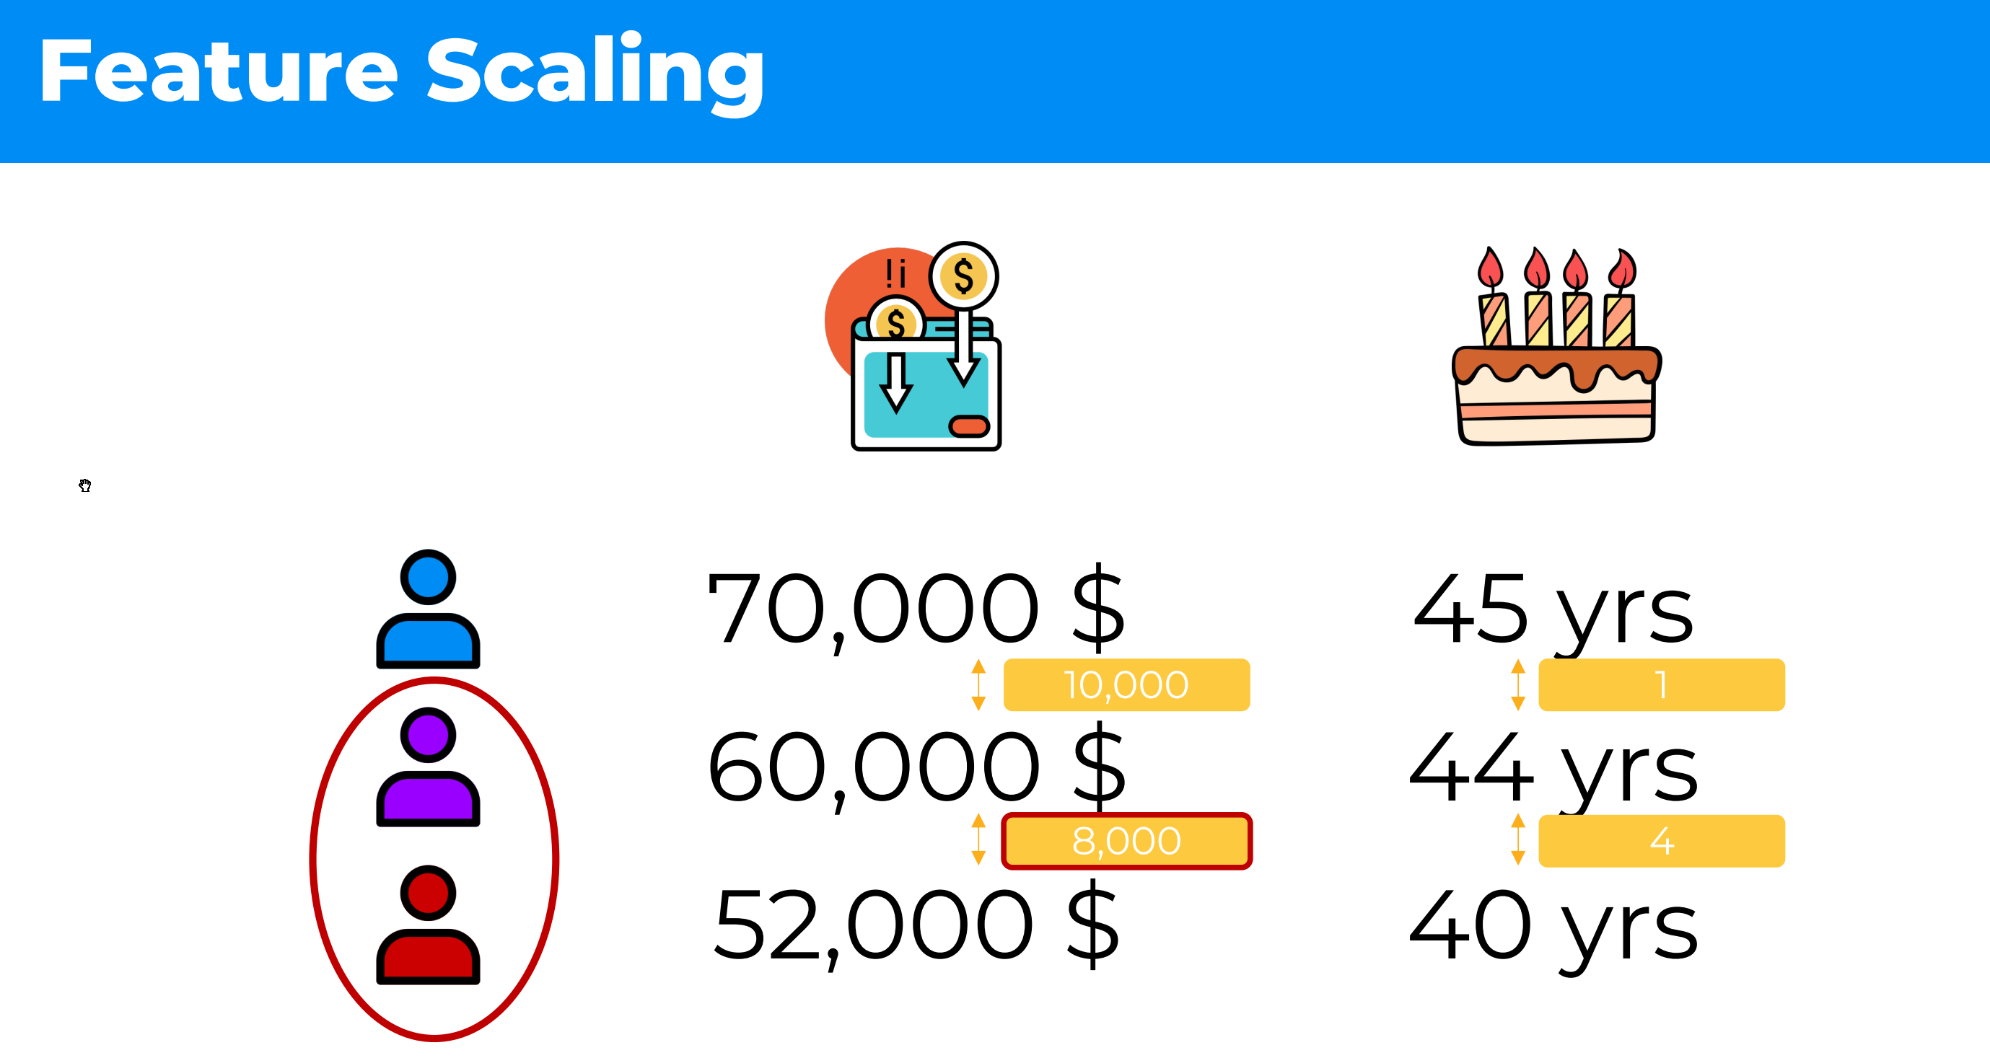

Slide 16
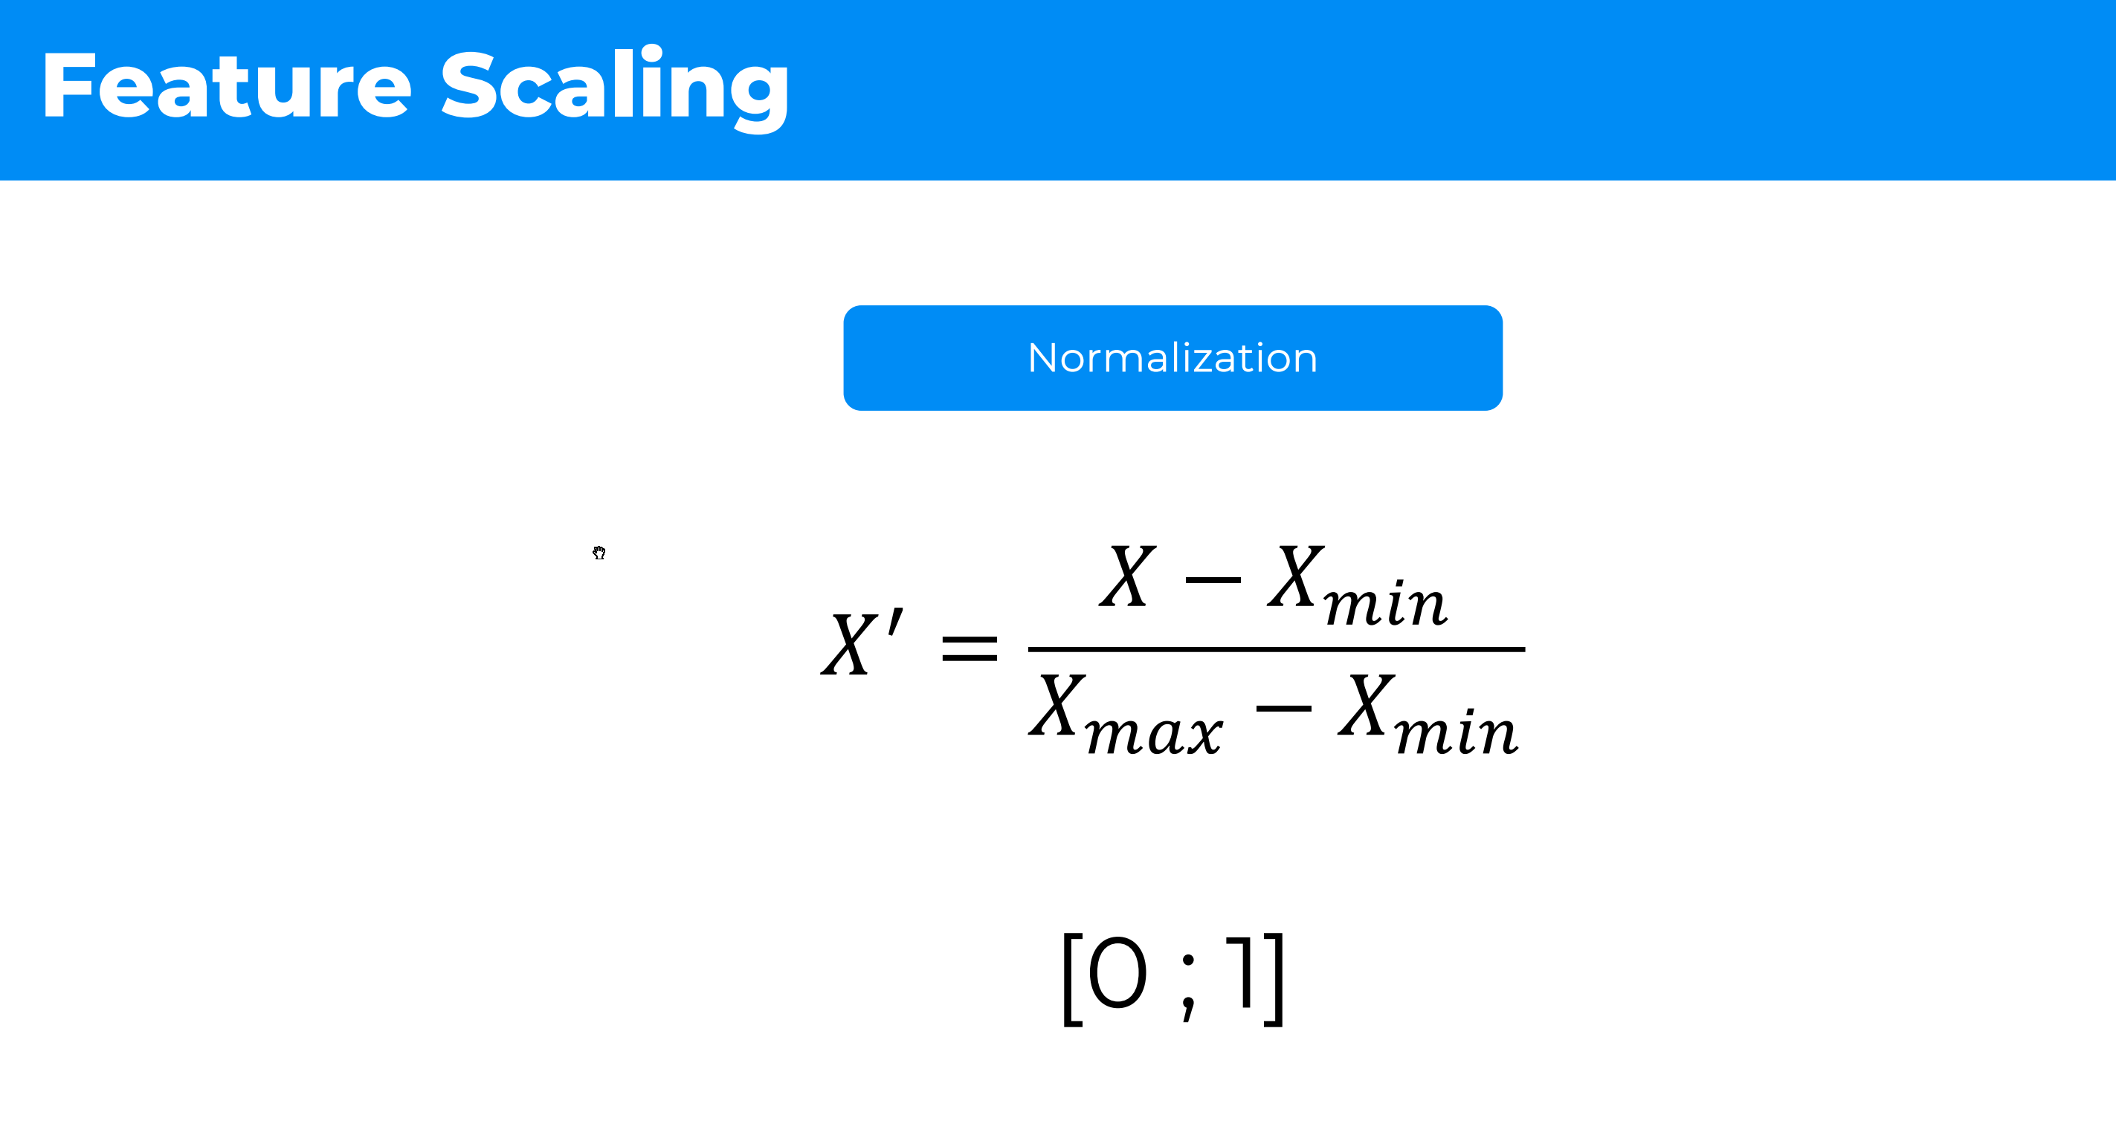

Slide 17
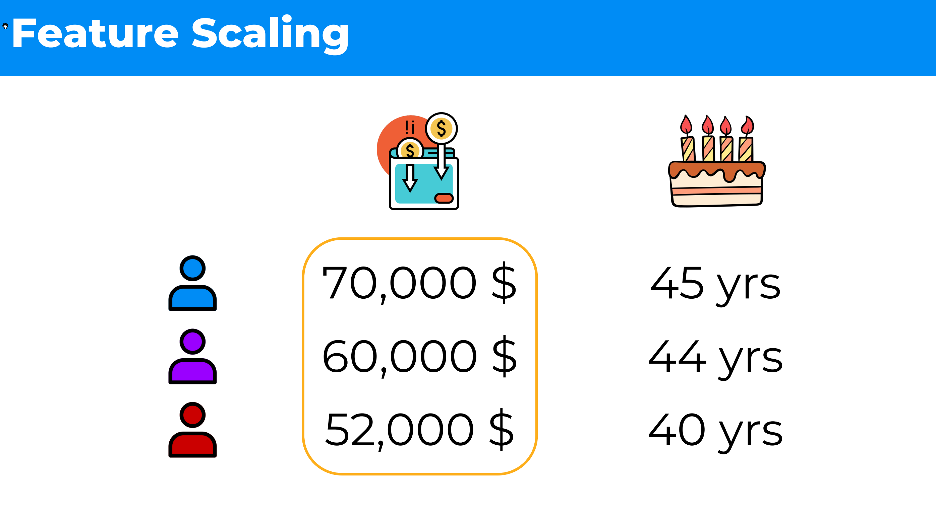

Slide 18
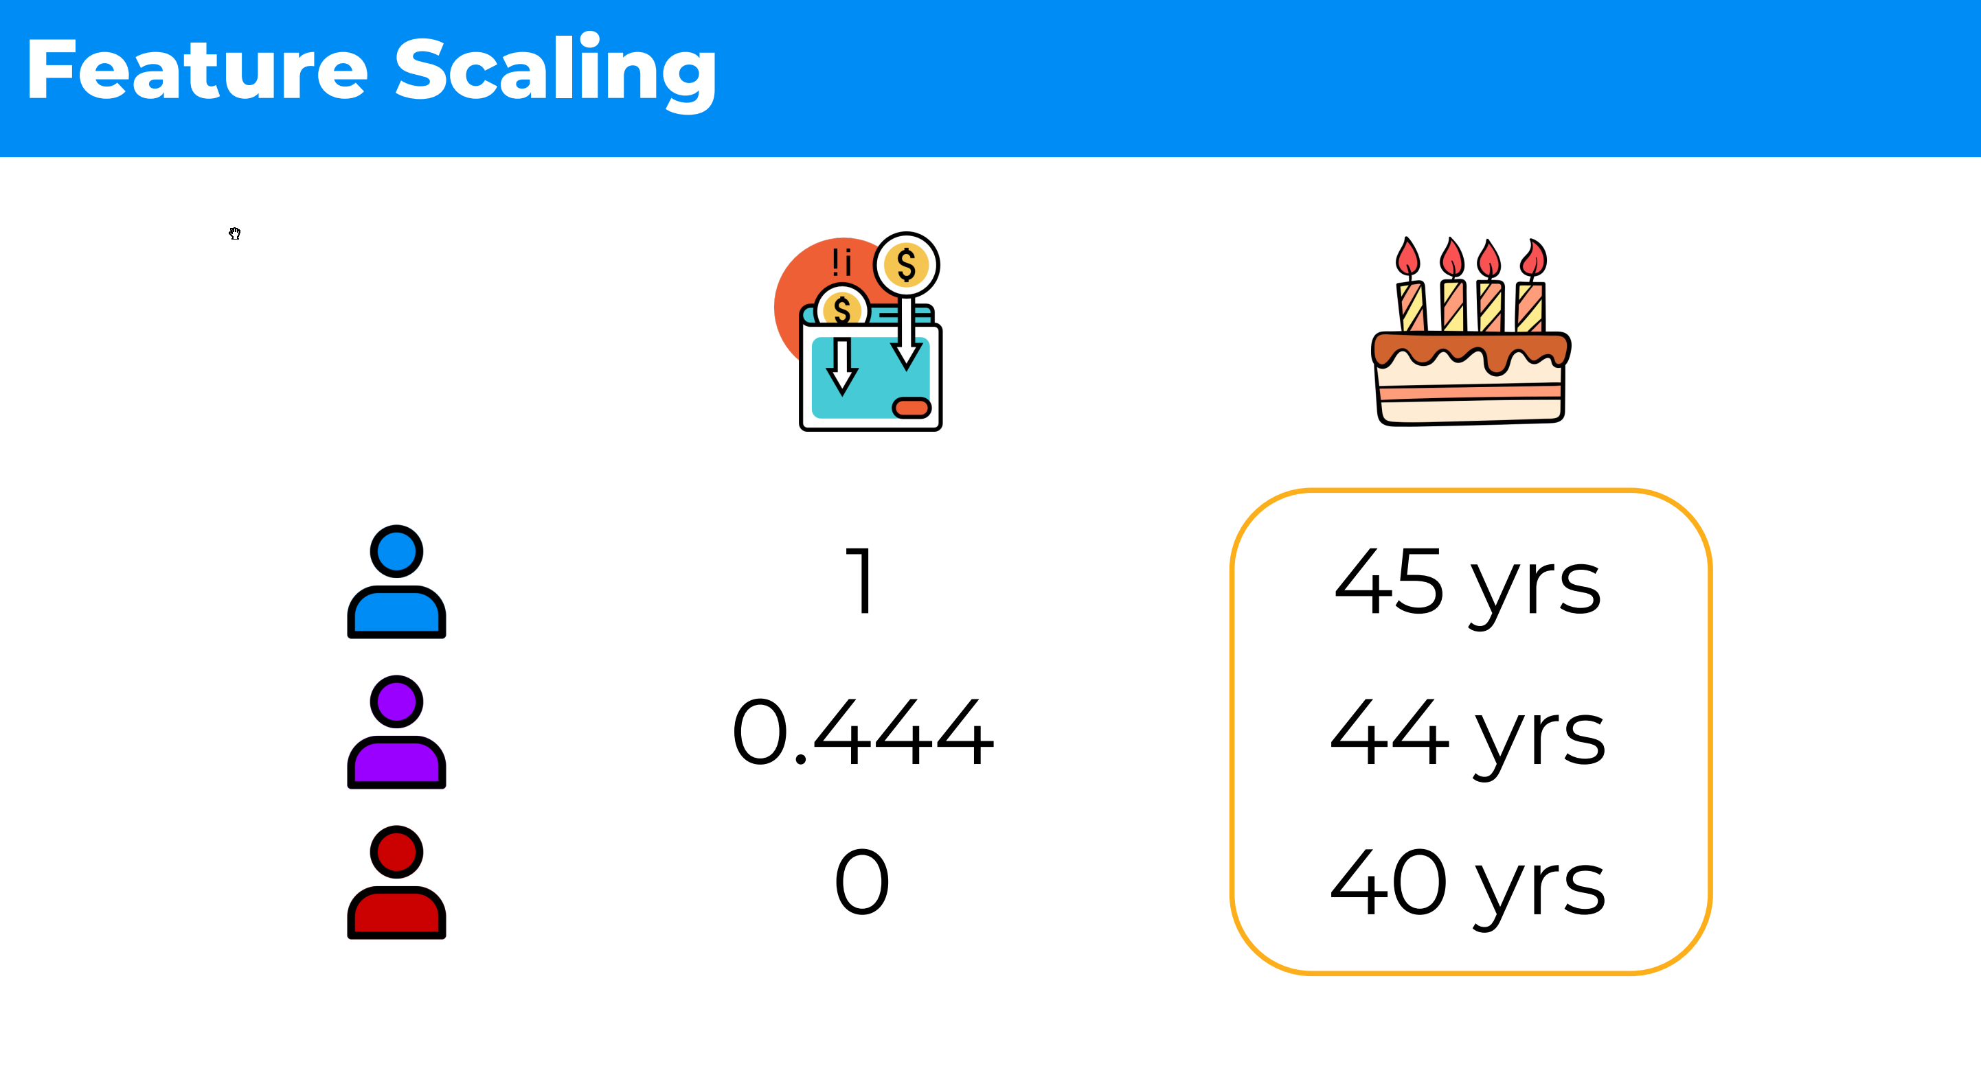

Slide 19
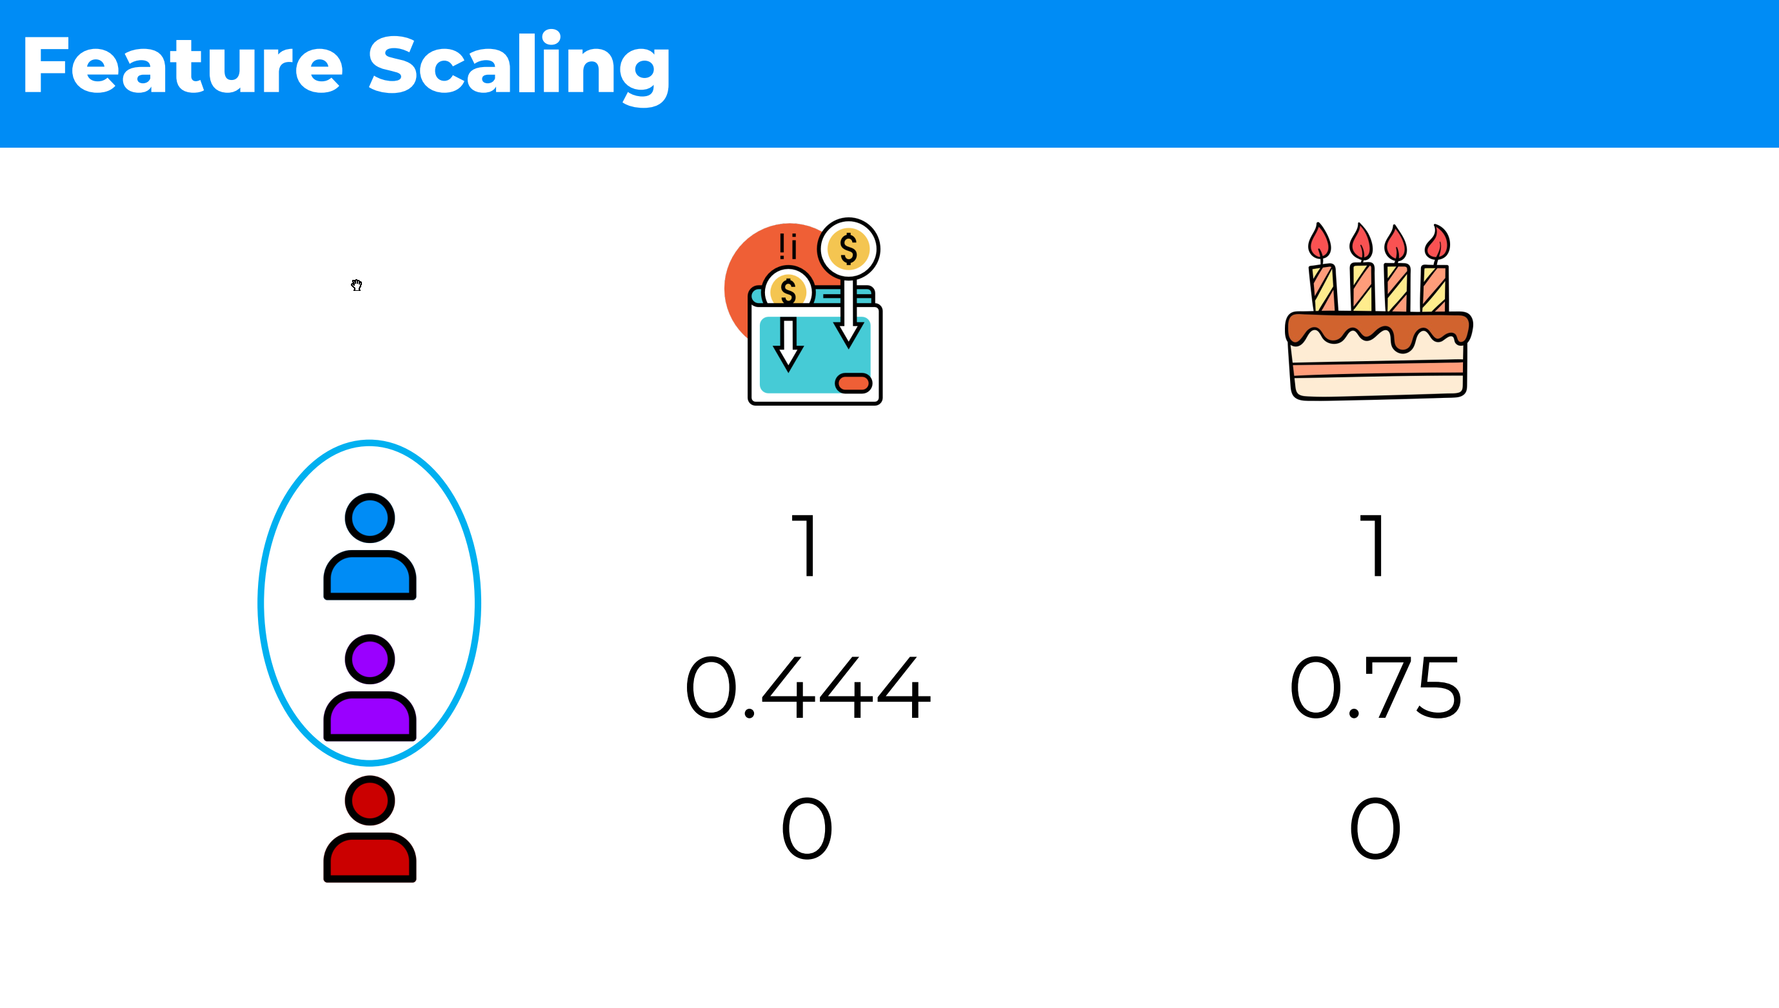

Slide 20
Categorical data
has a finite number of categories or labels for its values, 2 main types
Ordinal categorical variables
values follow a natural order, e.g. primary school, high school, college, university
Nominal categorical variables
values do not follow a natural order, e.g. colors, gender, countries, states

Slide 21
ML models and categorical data
Some models can work with categorical data directly
e.g. decision tree
Most models cannot operate using string inputs
All input and output variables must be numeric
mostly a constraint of efficient implementation of ML algorithms rather than hard limitations, e.g. scikit-learn

Slide 22
Categorical variable encoding
Conversion of categorical data to numeric form
either of feature variable or target variable
If target variable is categorical
may need to convert predictions by the model back into a categorical form in order to present them or use them in some application

Slide 23
Categorical variable encoding types
Ordinal / Label Encoding
One-Hot Encoding
Dummy Encoding

Slide 24
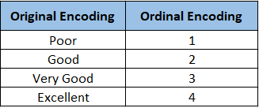

Slide 25
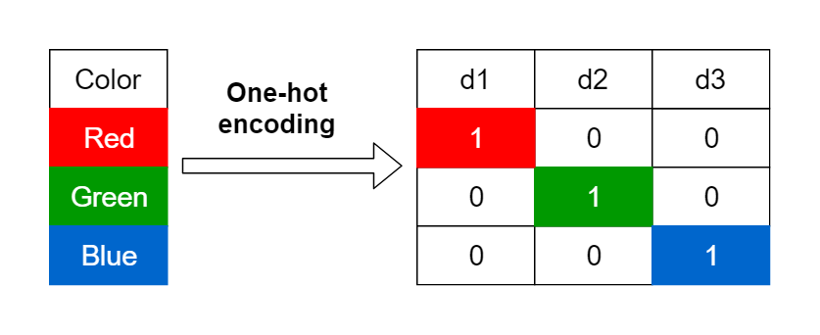
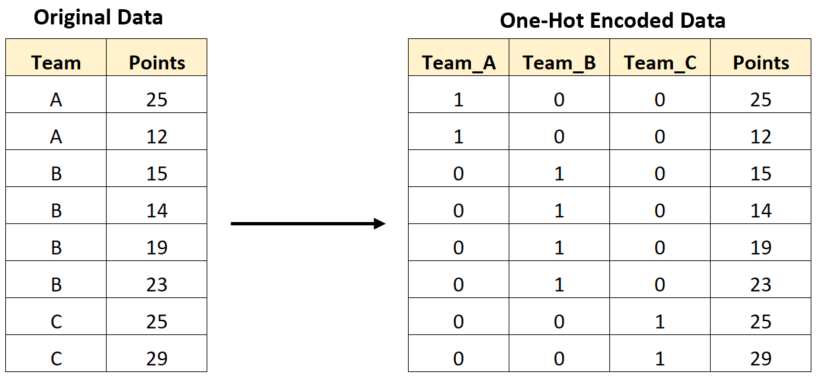

Slide 26
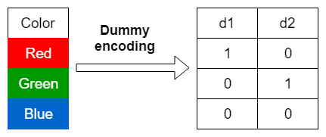
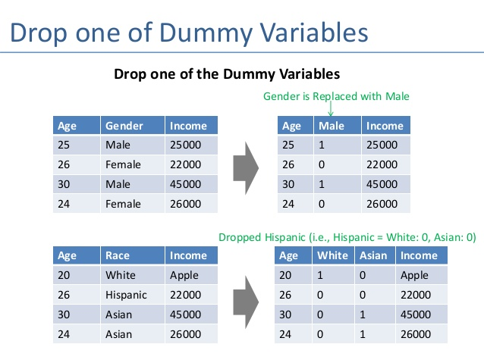
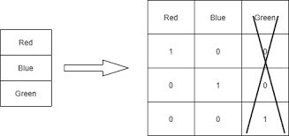

Slide 27
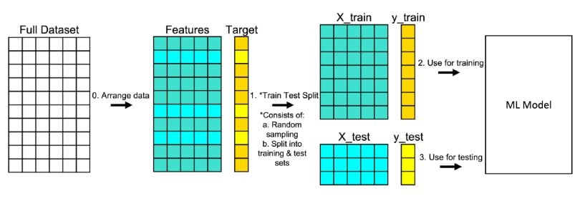
Training and test data split

Slide 28
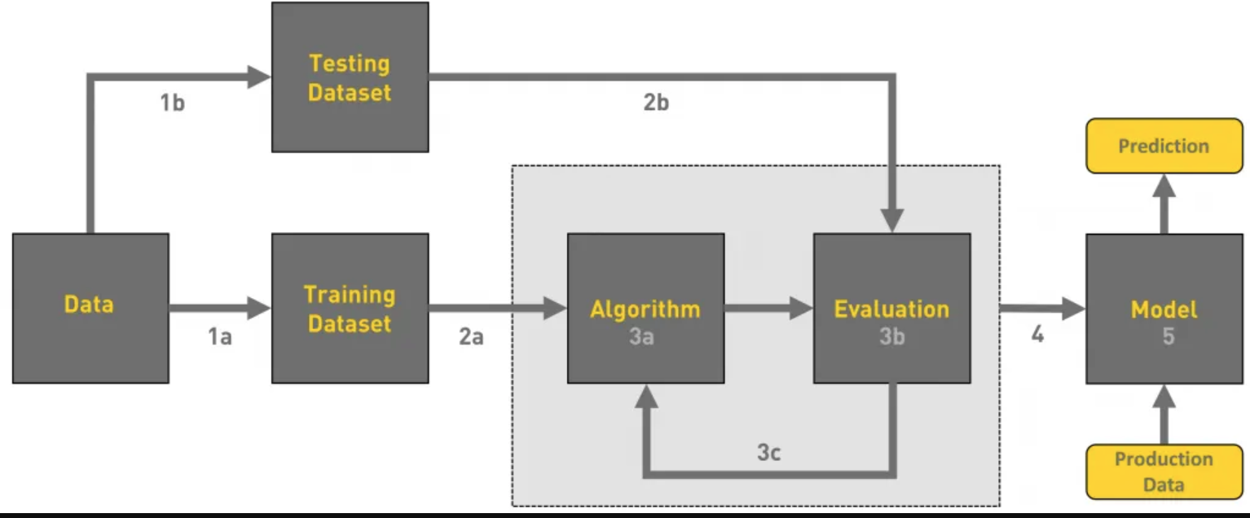
Machine Learning Workflow

